Slide 1
Learning Mixtures of Localized Rules by maximizing the Area Under the ROC Curve
Warichet Sébastien
Deschamps-Berger Théo
Machine learning course
Tutor: M Caio

Slide 2
Summary
Context
Keywords
Input
Output
Algorithm
Step 1: Mining new rules
Step 2: Estimating the relevance function of a rule
Step 3: Weight optimization of all rules
Compare the algorithm with other learning methods

Slide 3
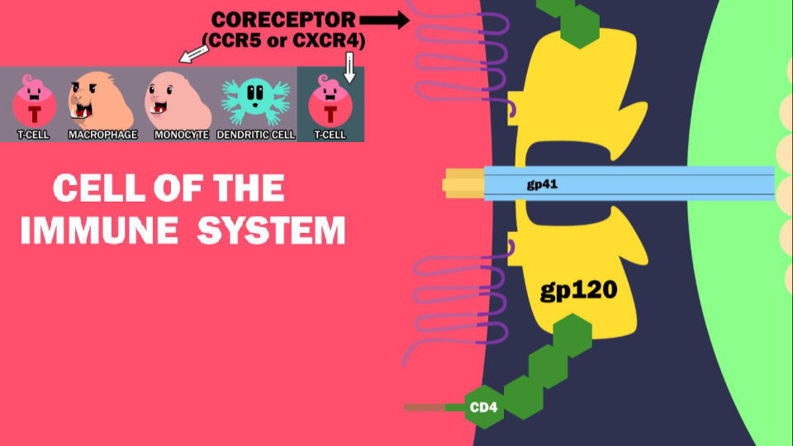
Context
HIV
R5 virus can use the CCR5 receptor
X4 virus can use the CXR4 receptor
R5X4 virus can use both receptor
class 1 for X4 and R5X4 virus
class -1 for R5 virus

Slide 4
2. Keywords
One instance is a list of amino acids of fixed length L.
The space X represents the list of instances.
1110 instances from 332 patients
A rule is a common pattern in the sequence of amino-acids.
The goal of the algorithm is to predict using instances which coreceptor will be used by HIV.
Thus which type of HIV we have in the blood

Slide 5
3. Input
Training data {(x1,y1) … (xn,yn)}
X (x1,x2…xn) is a set of all aligned amino acid sequences of fixed length L (instances).
Gap symbols are used to align amino acid in sequence.
Parameter K the number of iterations of the algorithm we will use

Slide 6
4. Output
A mixture of localized rules
h(x) = ∑ wi * reli* ri(x)
“wi” is the weight of the rules
“reli” the relevance coefficient (related to the background)
“ri(x)” the rule.
h(x) is between -1 and 1

Slide 7
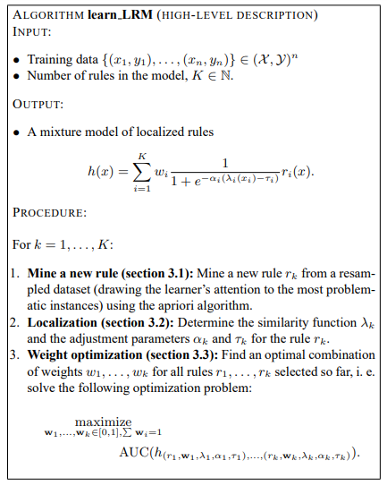
5. Algorithm
For k = 1, …, K:
Step 1: Mining a rule
Resampling
A priori algorithm
Scoring the rules
Generalizing the rules
Selecting the highest-scoring compatible rule
Step 2: Estimating the relevance function of a rule
Step 3: Weight optimization of all rules

Slide 8
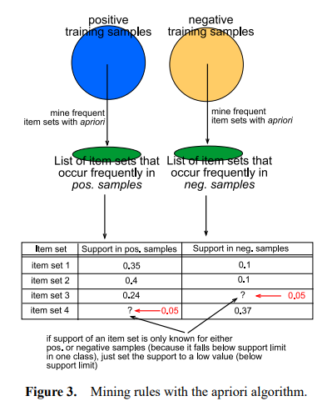
5. Algorithm
Step 1: Mining a rule
Resampling when k > 1 (Build a new dataset)
We will give higher weights to the instances which had incorrect predictions with the learning mixtures of rules of the previous iteration.
A priori algorithm cf Figure 3
Split instances in class 1 and -1
Find patterns that occur in multiple instances of the same class
Group the instances with the same pattern in item set dedicated
Compute the Support of each item set by class
Count instances which have the same pattern divided by the number of all instances in a class
If the support for a specific pattern is higher for the class 1 than -1, we predict the class 1 otherwise the class -1.
Notes:
Then we will build a new training dataset
We iteratively pick one instance in our data with a specific weight then put in our dataset

Slide 9
5. Algorithm
Step 1: Mining a rule
Scoring
We split the training set into two parts, Dcorrect represents the sample with the correct prediction.
A good rule has Dcorrect (correct prediction) high and Dincorrect low.
If a rule has a high score but has a very limited number of instances the score of the rule must decrease.
Generalizing
To prevent overfitting, selected rules must be generalized. A rule more general has less preconditions (number and index of amino acid in the sequence).
We will try at most to shortened a rule (pattern) until the score doesn’t change.
Selecting the highest-scoring compatible rule
A rule is compatible if it is not more general/specific than all previous rules.
We add the rule compatible with the highest score.
Notes:
The result of this is that we add different rules over each iteration

Slide 10
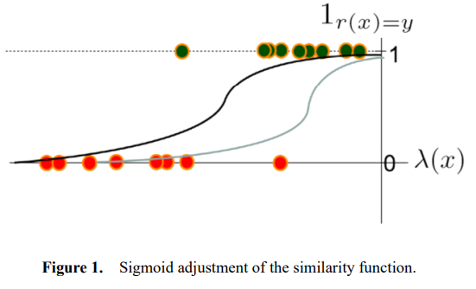
5. Algorithm
b. Step 2: Estimating the relevance function of the rule
Reminder: rule describe a pattern of mutation in the amino acid sequence
We assume that the effect of a particular pattern of mutations will be similar within the same genetic backgrounds
First the similarity λ(x) function of a rule is estimated for each instance (amino acid sequence).
This function is transformed into relevance function. cf Figure 1
To optimize the slope and the shift of the sigmoid we use a gradient descent.
Notes:
We assume that the effect of a particular pattern of mutations (as described by a rule) will be similar if it occurs within genetic backgrounds that are similar to each other

Slide 11


5. Algorithm
c. Step 3: Weights optimization of all rules
Reminder: objective function is a loss function that must be maximized.
The goal is to find weights w ∗ 1, . . . , w∗ k of our rules optimized using area under the ROC curve (AUC) as the objective function.
From Wikipedia we know that:
where U1 is the Mann-Whitney U statistic
In our case:
Notes:
We have |D+|*|D-| pair of examples.
To obtain AUC we count all pairs where prediction hw(x+)>hw(x-) (Each pair well predicted)
To facilitate the calculation of the gradient we use a sigmoid function g(x).
To maximize this equation, we compute the gradient ascent of AUC under all weights (wi). Finally the weights are adjusted …. Let’s try to add a new rule :-)

Slide 12
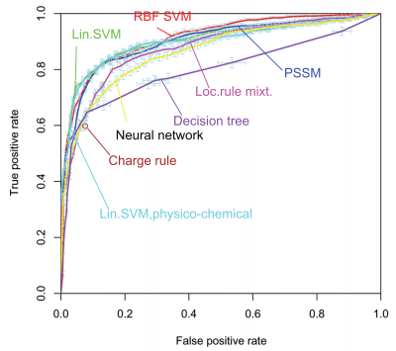
6. Compare learning method
SVM > LRM
Reminder: Kernels are used to modify the space and transform it into a linearly separable problem
We can notice that different Kernels gave closed results, perhaps it means that the problem is already linearly separable.
LRM > NN
LRM used Area Under ROC curve as “loss function” and to score the method. On the other hand, Neural Network is optimized with another function.
Another possible cause is that NN needs more data, and 1110 sequences is not enough (underfitting case).

